Slide 1
Dictionaries & AI Tools
TIP101
Notes:
🌟 Purpose: Introduce the session and prepare students for learning about dictionaries and AI tools.
✅ What should I be doing?
Welcome students and set a positive tone for the session.
Highlight the relevance of the day’s topics.
🎙️ What should I be saying?
Welcome to Week 2, Session 2 of TIP101! Today, we’re exploring two essential topics: dictionaries and AI tools. Dictionaries are a powerful data structure in Python, and AI tools can help you become more efficient learners and problem-solvers.
By the end of today, you’ll have a better understanding of when to use dictionaries and how to integrate AI tools thoughtfully into your learning process.
🙌🏽 How should I engage students?
Ask: "What’s one thing you’re excited to learn or improve on today?"

Slide 2
1 | Welcome 👋🏽 | 10 minutes
2 | Dictionaries & AI Tools | 35 minutes
3 | BREAK | 5 minutes
4 | Collaborative Problem Solving | 60 minutes
5 | Wrap Up | 10 minutes
Notes:
🌟 Purpose: Provide a roadmap for the session and set expectations.
✅ What should I be doing?
Walk students through the session’s structure.
🎙️ What should I be saying?
Here’s what we have planned for today: We’ll start with an introduction to dictionaries and AI tools, followed by a quick break. Then, we’ll jump into collaborative problem-solving before wrapping up with reflections and reminders.
The focus is on applying these concepts effectively in real-world problem-solving.
🙌🏽 How should I engage students?
Pause to ask if anyone has questions about the agenda.

Slide 3
Welcome! 👋🏽
10 minutes

Slide 4


Turn on your cameras
Fill out the entry ticket
Notes:
🌟 Purpose: Encourage visual engagement to foster connection during the session.
✅ What should I be doing?
Prompt students to enable their cameras and submit the entry ticket.
🎙️ What should I be saying?
Let’s kick off our session by turning on our cameras!
Also, don’t forget to fill out the entry ticket to help us organize breakout rooms later.
🙌🏽 How should I engage students?
Use humor or compliments: "Let’s see those smiles!"
Acknowledge and thank students who turn on their cameras.

Slide 5

Announcements & Reminders
Assessment Reminder:
Students must submit one attempted HackerRank assessment weekly to remain in the course (due Sunday at 11:59pm PST).
If a student moves ahead early in the units, and finishes passes all 10 units, they no longer require weekly attempts, but attendance is still mandatory.
Keep on eye on the Zoom chat during breakout rooms.
Notes:
🌟 Purpose: purpose
✅ What should I be doing?
Stuff
🎙️ What should I be saying?
Stuff
🙌🏽 How should I engage students?
stuff

Slide 6
Breakout rooms going well!
Students are finding cheat sheets and other resources helpful.
- Need more prep material.
- Some students asking for more data structure explanations.
Notes:
🌟 Purpose: Share feedback from the previous session and highlight areas of success and improvement.
✅ What should I be doing?
Summarize feedback from the previous session's survey and present key takeaways.
🎙️ What should I be saying?
From your feedback, it seems many of you enjoyed [highlighted aspect]. One suggestion was [area for improvement]. We’ll work on that today.
🙌🏽 How should I engage students?
Ask: "Does anyone have additional feedback or suggestions?"

Slide 7
5 minutes
🍦Question:
Let’s settle it once and for all. What truly is the best ice cream flavor? (And what’s the worst one 🤪?)
💬Answer:
Share your answer in the Zoom chat below. Multiple options are encouraged.

Slide 8

Choosing Your Breakout Room
We’ll share the link to the entry ticket so you can indicate what unit you are on.
We’ll create breakout groups based on the unit you selected.
When it’s Collaborative Problem Solving time, we’ll share the room assignments and demonstrate how to get to your room.
Notes:
🌟 Purpose: Prepare students for collaborative problem-solving time.
✅ What should I be doing?
Explain the breakout room process and answer any logistical questions.
🎙️ What should I be saying?
We’ll use your entry tickets to assign breakout rooms based on your progress in the course. Once assigned, you’ll navigate to your room and start working with your group.

Slide 9
Dictionaries & AI Tools
35 minutes

Slide 10
5 minutes
When is it best to use a list?
What about a dictionary?
Notes:
🌟 Purpose: Help students differentiate between when to use lists and dictionaries.
✅ What should I be doing?
Facilitate a discussion to assess understanding.
🎙️ What should I be saying?
Let’s think about when to use a list versus a dictionary. Lists are great for ordered data and iteration, while dictionaries are best for key-value mappings and quick lookups.
For example, if you’re storing a sequence of names in order, a list makes sense. But if you want to map names to ages, a dictionary is the better choice.
🙌🏽 How should I engage students?
Ask: "Can someone share an example of when they’ve used a list and a dictionary in the past?"

Slide 11
Understand When to Use Each
Lists are great for ordered data and iteration:
Keeping data in chronological order.
Arrival time matters (first come first served).
Size expected to be constant (12 slots for monthly revenue).
Dictionaries for key-value mapping
Dynamically grows as new data is added.
Speed is prioritized.
Unknown keys (user input).
Notes:
🌟 Purpose: Reinforce the differences between lists and dictionaries with practical examples.
✅ What should I be doing?
Provide clear examples to illustrate each use case.
🎙️ What should I be saying?
Lists are perfect for ordered collections of data that you’ll loop through. Dictionaries are ideal when you need to associate data using keys, like a phonebook or a frequency counter.
For instance, if you’re building a program that counts the number of times each word appears in a text, a dictionary would let you map each word to its count efficiently.
🙌🏽 How should I engage students?
Prompt: "Which data structure would you use to store a collection of email addresses and the number of emails each person has sent?"

Slide 12
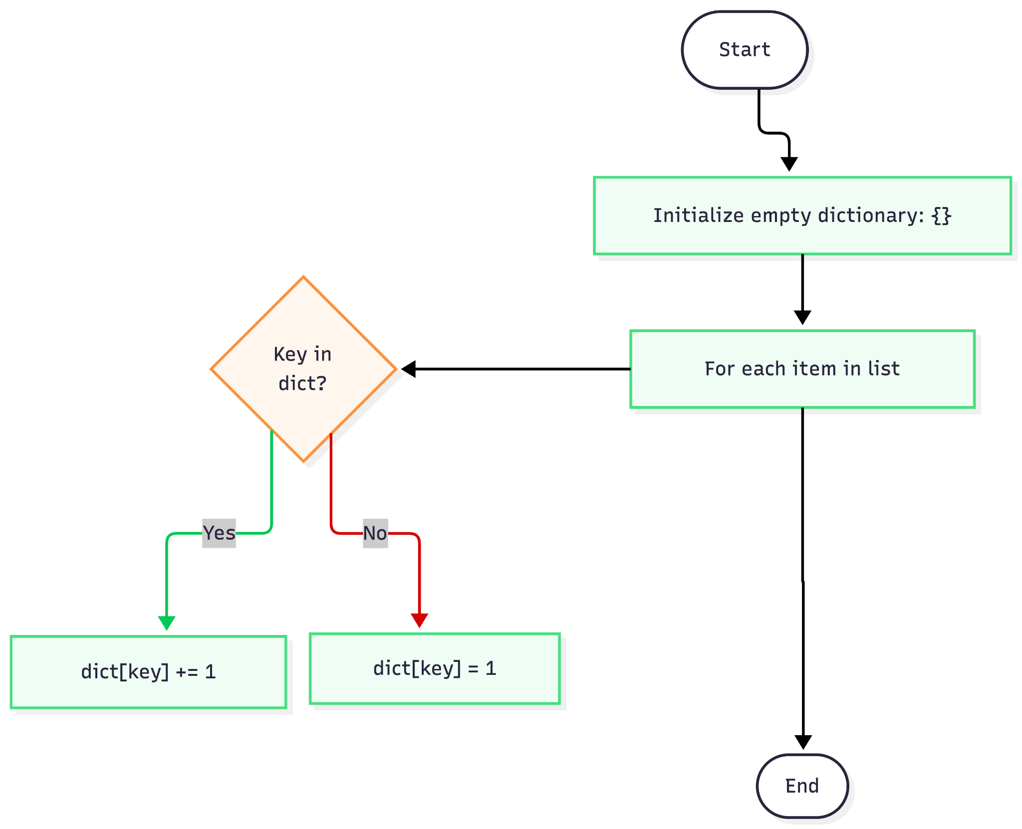
Frequency Map Flowchart
Notes:
🌟 Purpose: Reinforce the differences between lists and dictionaries with practical examples.
✅ What should I be doing?
Provide clear examples to illustrate each use case.
🎙️ What should I be saying?
Lists are perfect for ordered collections of data that you’ll loop through. Dictionaries are ideal when you need to associate data using keys, like a phonebook or a frequency counter.
For instance, if you’re building a program that counts the number of times each word appears in a text, a dictionary would let you map each word to its count efficiently.
🙌🏽 How should I engage students?
Prompt: "Which data structure would you use to store a collection of email addresses and the number of emails each person has sent?"

Slide 13
3 minutes
In the chat . . .
Have you ever used an AI tool like Claude or Copilot for learning?
How did it help you?
Any specific classes/project types where it performed best?
Notes:
🌟 Purpose: Facilitate a conversation about students’ experiences with AI tools.
✅ What should I be doing?
Create a space for students to share their thoughts on using AI tools like ChatGPT or GitHub Copilot.
🎙️ What should I be saying?
Let’s talk about AI tools. Have you ever used a tool like ChatGPT or Copilot for learning? How did it help you?
AI tools are becoming more common for debugging, brainstorming, and learning complex concepts. They can help you work through challenges or provide new perspectives.
🙌🏽 How should I engage students?
Ask students to share their experiences in the chat or unmute to contribute. Follow up with: "What are some benefits or challenges you’ve noticed when using these tools?"

Slide 14
You are given a list of tuples, where each tuple contains a category and a value. Write a function to count how many items belong to each category.
def count_by_category(items):
pass
Input: items = [("fruits", "apple"), ("vegetables", "carrot"), ("fruits", "banana")]
Output: {"fruits": 2, "vegetables": 1}
Notes:
🌟 Purpose: Demonstrate solving a problem using the UMPIRE strategy, with an emphasis on the utility of dictionaries for categorizing data.
✅ What should I be doing?
Guide students step-by-step through solving the problem using the UMPIRE framework.
Showcase the strengths of dictionaries in categorization tasks.
Normalize mistakes by intentionally introducing an error and debugging it.
🎙️ What should I be saying?
1. Understand the Problem
"Let’s start with the first step of UMPIRE—Understand. The problem asks us to count how many items belong to each category in a list of tuples. Each tuple contains a category and a value."
"Our input is a list of tuples, and our output is a dictionary where the keys are categories and the values are the counts of items in those categories."
"For example, if the input is [('fruits', 'apple'), ('vegetables', 'carrot'), ('fruits', 'banana')], the output should be {'fruits': 2, 'vegetables': 1}."
Ask Students: "What edge cases should we think about for this problem? For example, what happens if the input list is empty?"
2. Plan the Solution
"Next, let’s create a plan. Here’s how we’ll approach the problem:
Initialize an empty dictionary.
Loop through each tuple in the input list.
For each tuple, check if the category (the first element) is already a key in the dictionary.
If it is, increment its value. If not, create a new key with a value of 1.
Return the dictionary at the end."
Ask Students: "Does this plan make sense? Can you think of anything we might have missed?"
3. Implement the Solution
"Let’s turn our plan into Python code. I’ll start by defining the function and implementing each step."
Write the code step by step, explaining each line: def count_by_category(items):
counts = {} # Step 1: Initialize an empty dictionary
for category, _ in items: # Step 2: Loop through each tuple
if category in counts: # Step 3a: Check if the key exists
counts[category] += 1 # Step 3b: Increment the count
else:
counts[category] = 1 # Step 3c: Add a new key with value 1
return counts # Step 5: Return the dictionary
Normalize Mistakes: Introduce a small error, such as forgetting to initialize the dictionary or misnaming a variable.
Example: Forget to increment the count correctly.
"Hmm, why is this returning the wrong output? Let’s debug by printing the dictionary at each step."
Debug and correct the code.
4. Test the Solution
"Now let’s test the function with some cases. We’ll start with the input [('fruits', 'apple'), ('vegetables', 'carrot'), ('fruits', 'banana')]. The expected output is {'fruits': 2, 'vegetables': 1}."
Run the test case and verify the output.
Ask Students: "What additional test cases should we try? For example, how should the function behave with an empty list or duplicate categories?"
5. Review and Reflect
"Let’s reflect on what we did. Dictionaries made it easy to group and count items by category. They’re efficient and flexible for this type of task."
"If we had used a list or another data structure, this task would have been more complex."
Ask Students: "Why do you think dictionaries are the best choice for this problem? Can you think of a similar problem where they’d be useful?"
🙌🏽 How should I engage students?
Encourage active participation by asking:
"What should our next step be?"
"Why is it important to check if the key exists in the dictionary before incrementing?"
Celebrate correct contributions and provide constructive feedback on errors.
Use mistakes as teachable moments: "Mistakes like these are common, and debugging them is how we grow as programmers."

Slide 15

Balancing AI with Independent Learning
Use AI as a supplement, not a replacement, for your own problem-solving!
Notes:
🌟 Purpose: Highlight the importance of combining AI tools with personal effort.
✅ What should I be doing?
Emphasize the role of AI tools as supplements, not replacements, for critical thinking.
🎙️ What should I be saying?
While AI tools can be incredibly helpful, it’s important to use them as a supplement, not a replacement, for your own problem-solving.
Over-reliance on AI can hinder your ability to think critically and develop your skills. Use these tools to support your learning, not to do the work for you.
For example, if you’re stuck, ask an AI tool for hints or suggestions, but make sure to try implementing and debugging the solution yourself.
🙌🏽 How should I engage students?
Ask: "What’s one way you can use an AI tool to enhance your learning while still challenging yourself to think critically?"

Slide 16
Balancing AI with Independent Learning
Use AI as a supplement, not a replacement, for your own problem-solving!
Prompt engineering: Giving explicit instructions with each prompt to assist you better.
Notes:
🌟 Purpose: Highlight the importance of combining AI tools with personal effort.
✅ What should I be doing?
Emphasize the role of AI tools as supplements, not replacements, for critical thinking.
🎙️ What should I be saying?
While AI tools can be incredibly helpful, it’s important to use them as a supplement, not a replacement, for your own problem-solving.
Over-reliance on AI can hinder your ability to think critically and develop your skills. Use these tools to support your learning, not to do the work for you.
For example, if you’re stuck, ask an AI tool for hints or suggestions, but make sure to try implementing and debugging the solution yourself.
🙌🏽 How should I engage students?
Ask: "What’s one way you can use an AI tool to enhance your learning while still challenging yourself to think critically?"

Slide 17
Balancing AI with Independent Learning
Use AI as a supplement, not a replacement, for your own problem-solving!
Role engineering: “Please act as a TA, and guide me through this question without giving the solution right away.”
Notes:
🌟 Purpose: Highlight the importance of combining AI tools with personal effort.
✅ What should I be doing?
Emphasize the role of AI tools as supplements, not replacements, for critical thinking.
🎙️ What should I be saying?
While AI tools can be incredibly helpful, it’s important to use them as a supplement, not a replacement, for your own problem-solving.
Over-reliance on AI can hinder your ability to think critically and develop your skills. Use these tools to support your learning, not to do the work for you.
For example, if you’re stuck, ask an AI tool for hints or suggestions, but make sure to try implementing and debugging the solution yourself.
🙌🏽 How should I engage students?
Ask: "What’s one way you can use an AI tool to enhance your learning while still challenging yourself to think critically?"

Slide 18
Balancing AI with Independent Learning
Use AI as a supplement, not a replacement, for your own problem-solving!
Debugging: Sharing your code with AI for debugging can speed up your efficiency without taking away from your learnings.
Notes:
🌟 Purpose: Highlight the importance of combining AI tools with personal effort.
✅ What should I be doing?
Emphasize the role of AI tools as supplements, not replacements, for critical thinking.
🎙️ What should I be saying?
While AI tools can be incredibly helpful, it’s important to use them as a supplement, not a replacement, for your own problem-solving.
Over-reliance on AI can hinder your ability to think critically and develop your skills. Use these tools to support your learning, not to do the work for you.
For example, if you’re stuck, ask an AI tool for hints or suggestions, but make sure to try implementing and debugging the solution yourself.
🙌🏽 How should I engage students?
Ask: "What’s one way you can use an AI tool to enhance your learning while still challenging yourself to think critically?"

Slide 19
Balancing AI with Independent Learning
Use AI as a supplement, not a replacement, for your own problem-solving!
Optimizing Solutions: Even if you come up with a working solution on your own, AI can be helpful in improving your solution’s efficiency.
Notes:
🌟 Purpose: Highlight the importance of combining AI tools with personal effort.
✅ What should I be doing?
Emphasize the role of AI tools as supplements, not replacements, for critical thinking.
🎙️ What should I be saying?
While AI tools can be incredibly helpful, it’s important to use them as a supplement, not a replacement, for your own problem-solving.
Over-reliance on AI can hinder your ability to think critically and develop your skills. Use these tools to support your learning, not to do the work for you.
For example, if you’re stuck, ask an AI tool for hints or suggestions, but make sure to try implementing and debugging the solution yourself.
🙌🏽 How should I engage students?
Ask: "What’s one way you can use an AI tool to enhance your learning while still challenging yourself to think critically?"

Slide 20
Balancing AI with Independent Learning
Use AI as a supplement, not a replacement, for your own problem-solving!
Back and forth: If you are absolutely hitting a wall in your studies, try spending 20-30min between allowing yourself to use AI.
Notes:
🌟 Purpose: Highlight the importance of combining AI tools with personal effort.
✅ What should I be doing?
Emphasize the role of AI tools as supplements, not replacements, for critical thinking.
🎙️ What should I be saying?
While AI tools can be incredibly helpful, it’s important to use them as a supplement, not a replacement, for your own problem-solving.
Over-reliance on AI can hinder your ability to think critically and develop your skills. Use these tools to support your learning, not to do the work for you.
For example, if you’re stuck, ask an AI tool for hints or suggestions, but make sure to try implementing and debugging the solution yourself.
🙌🏽 How should I engage students?
Ask: "What’s one way you can use an AI tool to enhance your learning while still challenging yourself to think critically?"

Slide 21

Break Time!
Take 5 mins to step away from the computer. Feel free to turn off your camera and return promptly after 5 mins.
Notes:
🌟 Purpose: Provide a short break to refresh and re-energize.
✅ What should I be doing?
Announce the break and remind students to return on time.
Play the countdown timer video (be sure to share sound).
🎙️ What should I be saying?
Let’s take 5 minutes to step away from the screen. Be sure to return promptly.

Slide 22
Collaborative Problem Solving
60 minutes

Slide 23
Choosing Your Breakout Room
We’ll share the room assignments.
We’ll demonstrate how to find your room assignment and navigate to your room.
Notes:
🌟 Purpose: Smoothly transition students into breakout rooms for collaboration.
✅ What should I be doing?
Share room assignments and explain how to join breakout rooms.
🎙️ What should I be saying?
Use the link to find your room and introduce yourself to your group.
🙌🏽 How should I engage students?
Check that everyone understands the process before sending them to breakout rooms.

Slide 24
60 minutes
🏃🏽 Navigate to your breakout room.
👋🏽 Introduce yourselves!
🧑🏽‍💻 Work on the problems for your selected unit.

Slide 25
Wrap Up
10 minutes

Slide 26
Notes:
🌟 Purpose: End the session on a positive note.
✅ What should I be doing?
Prompt students to share their reflections in the chat.
🎙️ What should I be saying?
Let’s celebrate your wins. Share one good thing you learned or accomplished today!
🙌🏽 How should I engage students?
Read a few responses aloud and celebrate with enthusiasm.

Slide 27


Session Survey Time!
Notes:
🌟 Purpose: Gather feedback to improve future sessions.
✅ What should I be doing?
Share the survey link and emphasize its importance.
🎙️ What should I be saying?
Your feedback helps us make these sessions even better. Please take a moment to complete the survey.
🙌🏽 How should I engage students?
Thank students for their input and explain how feedback has been used in the past.

Slide 28

Final Reminders
Finish the problem sets for additional practice
Take the weekly HackerRank assessment by Sunday @ midnight PST
Visit a Study Hall Session to deepen your understanding, work through challenges, and connect with course material alongside your peers!
Notes:
🌟 Purpose: Reinforce key tasks and deadlines.
✅ What should I be doing?
Summarize next steps and encourage continued engagement.
🎙️ What should I be saying?
Don’t forget to complete the problem sets and take the HackerRank assessment by Sunday!
🙌🏽 How should I engage students?
Encourage students to ask any lingering questions before signing off.

